Slide 1
babyhelper
Brand Name
Tagline : ‘Helping You Every step of the way’

Slide 2

Brand logo

Slide 3
1. Choosing the Right Audience for the Brand
a. Age:
Primary Audience: Parents and caregivers of infants and toddlers (typically ages 0-3 years).
Secondary Audience: Expecting parents (pregnant women), as they often start researching baby products before the baby arrives.

Slide 4
b. Location:
Urban vs. Rural: Consider focusing on urban areas where there is higher access to digital platforms and possibly more spending power.
Regional Preferences: Adapt marketing strategies to regional preferences and needs. For example, certain products might be more popular in specific regions due to cultural preferences.
c. Gender:
Parents (both mothers and fathers): Tailor marketing messages to appeal to both genders, but recognize that mothers might be the primary decision-makers for baby products.
Caregivers: Include grandparents and other caregivers who might purchase baby products.

Slide 5
d. Online Behaviors:
Social Media: Track which platforms parents use most frequently (e.g., Facebook, Instagram, Pinterest).
Search Behavior: Analyze common search terms related to baby care, such as "organic baby lotion," "gentle baby soap," etc.
Content Consumption: Identify the type of content they engage with (e.g., parenting tips, product reviews, DIY tips).
e. Buying Habits Online:
Purchase Frequency: Determine how often parents buy baby products online.
Preferred Channels: Identify whether they prefer buying directly from brand websites, e-commerce platforms like Amazon, or other retail sites.
Price Sensitivity: Analyze how price-sensitive your audience is and how often they look for discounts or promotions

Slide 6
2. Competitor Analysis
a. Direct Competitors:
Examples: Johnson’s Baby, Chicco, Aveeno Baby
Products: Compare product lines, including types (e.g., lotions, shampoos, wipes), ingredients, and formulations.
Costing: Assess pricing strategies. Are they premium, mid-range, or budget-friendly?
USPs (Unique Selling Points): Identify what sets them apart (e.g., hypoallergenic formulas, eco-friendly packaging).
Strengths:
Established reputation and trust
Extensive product range and availability
Weaknesses:
Potentially higher pricing
Generic or less personalized marketing

Slide 7
b. Indirect Competitors:
Examples: General skincare brands that offer baby lines, local or boutique baby care brands.
Products: Compare if they offer baby products or alternative solutions (e.g., natural/organic brands).
Costing: Look at their pricing structures to understand their positioning.
USPs:
Niche market focus
Specialized ingredients or formulations
Strengths:
Unique product offerings or formulations
Strong brand loyalty or community presence
Weaknesses:
Limited product range
Potentially less widespread distribution

Slide 8
c. What They Are Doing Right:
Effective Marketing: Strong social media presence, engaging content, and well-executed advertising campaigns.
Customer Trust: Building brand loyalty through consistent product quality and positive customer experiences.
Innovation: Offering new and unique products that meet emerging consumer needs
.
d. What They Are Lagging:
Product Variety: Limited range of products or failure to adapt to new trends.
Pricing: Overpricing or lack of competitive pricing strategies.
Online Presence: Weak or inconsistent digital marketing efforts and customer engagement.

Slide 9
BLOG
*Title:* and essential baby products that will make your parenting journey easier, safer, and more enjoyable"Revolutionizing Parenting: Discover the Ultimate Baby Products for a Stress-Free Journey“
*Introduction:* As a new parent, navigating the world of baby products can be overwhelming. With so many options available, it's challenging to know what's best for your little one. At BabyHelper.com, we understand the importance of making informed decisions when it comes to your baby's care. In this blog, we'll explore some of the most innovative

Slide 10
1. Smart Baby Monitors:*Gone are the days of traditional baby monitors that only allowed you to hear your baby's cries. Today's smart baby monitors offer a range of advanced features, including:
* High-definition video streaming
* Motion tracking
* Temperature sensors
* Two-way audio communication
* Mobile app connectivity Our top pick is the Owlet Smart Sock
*2. Baby Wearables:
*Baby wearables have become increasingly popular, and for good reason. These devices provide valuable insights into your baby's health, comfort, and development. Some notable features include:* Heart rate monitoring* Sleep tracking* Temperature control* Feeding reminders

Slide 11
*3. Eco-Friendly Diapering Essentials:*As a parent, you want the best for your baby and the planet. Eco-friendly diapering essentials are a great way to reduce your carbon footprint while keeping your baby clean and comfortable. Look for products made from sustainable materials, such as:* Bamboo diapers* Biodegradable wipes* Reusable cloth diapers
4. Baby Skincare:*Your baby's skin is delicate and requires special care. Harsh chemicals and artificial fragrances can irritate their skin, leading to discomfort and skin conditions. Opt for natural, organic skincare products that are
:* Hypoallergenic
* Fragrance-free
* Gentle on sensitive skin

Slide 12
*5. Baby Gear for On-the-Go Parents:
*As a parent, you're always on the move. Whether it's a trip to the park or a family vacation, you need baby gear that's portable, convenient, and safe. Some must-haves include:* Lightweight strollers* Compact baby carriers* Travel-friendly baby gear
*Conclusion:*At BabyHelper.com, we're dedicated to helping you navigate the world of baby products. From smart baby monitors to eco-friendly diapering essentials, we've got you covered. Remember, every baby is unique, and what works for one family may not work for another. Take the time to research, read reviews, and trust your instincts when choosing the best products for your little one. Happy parenting!

Slide 13
Keyword for brand the brand website
Average monthly search
500
50
50
50
500
50
50
500
50
50
50
50
50
500
Keyword Stats 2024-08-26 at 19_04_20
August 1, 2023 - July 31, 2024
Keyword
best wipes for sensitive skin
mustela gentle cleansing gel 500ml
best wet wipes for sensitive skin
best diaper wipes for sensitive skin
best soap for newborn sensitive skin
best diaper rash cream sensitive skin
best lotion for newborn sensitive skin
best soap for infants with sensitive skin
best water wipes for sensitive skin
cetaphil top to toe wash
chicco top to toe wash
best baby hygiene
himalaya top to toe wash
love boo very gentle top to toe wash
top to toe wash newborn
best gentle baby product
Compitition
High
High
High
Unknown
High
High
High
High
Unknown
High
High
Unknown
High
Unknown
High
Unknown

Slide 14
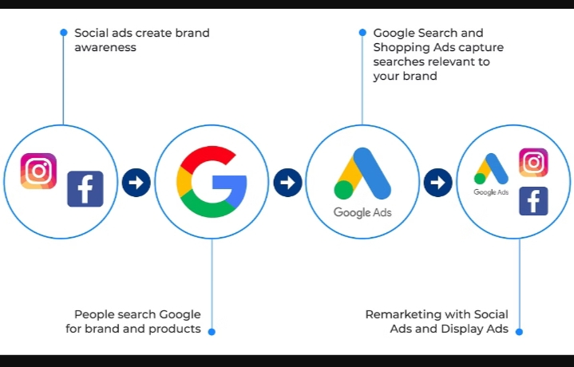
: Types of Google Ads for Social Media Marketing
Social media platforms have become a powerful marketing tool, and leveraging Google Ads can help businesses effectively reach their target audience. This presentation will guide you through the various types of Google Ads that can be used for social media marketing, along with best practices for selecting the right channels, creating engaging content, and optimizing your campaigns

Slide 15
: Picking the Right Social Media Channels
Audience Research:
Understand your target audience's preferences and behaviors on different social media platforms to determine the best channels for your business.
Platform Alignment:
Match the features and capabilities of social media platforms to your marketing goals and the type of content you plan to create.
Competitor Analysis:
Examine your competitors' social media presence and strategies to identify opportunities and differentiate your approach.

Slide 16

Developing Social Media Post Ideas
Evergreen Content:
Create timeless, valuable content that resonates with your audience and can be repurposed across multiple platforms.

Slide 17
Trending Topics:
Stay up-to-date with current events and conversations in your industry to capitalize on relevant trends.
User-Generated Content:
Encourage your audience to share their experiences and content, which can help build trust and engagement.
Seasonal Campaign :
Develop content and campaigns that align with holidays, events, or seasonal shifts in your industry

Slide 18
: Creating Engaging Content Copies
Compelling Headlines:
Craft attention-grabbing headlines that compel your audience to read and engage with your content.
Storytelling Approach:
Use a narrative-driven approach to connect with your audience on an emotional level and make your content more memorable.
Personalization:
Tailor your content to speak directly to your target audience and address their specific pain points or interests.
Concise and Clear:
Keep your copy straightforward, easy to read, and free from jargon to ensure your message is understood

Slide 19

Paid Social Media Marketing Approach
Audience Targeting:
Use detailed audience targeting options to reach the right people with your ads.
Ad Formats:
Leverage a variety of ad formats, such as image, video, and carousel ads, to capture attention.
Bidding Strategies:
Implement effective bidding strategies to optimize your ad spend and maximize campaign performance.
Remarketing:
Use remarketing to re-engage users who have already interacted with your brand or content

Slide 20

Optimizing Social Media Campaigns
A/B Testing:
Continuously test different ad creatives, copy, and targeting to identify the most effective elements.
Performance Tracking:
Monitor key metrics, such as click-through rate, conversion rate, and cost-per-acquisition, to identify areas for improvement
Audience Refinement:
Adjust your audience targeting based on performance data to reach the most relevant users

Slide 21
THANK YOU

